Slide 1
PROBLEM SOLVING & PROGRAM DESIGN

Slide 2
OBJECTIVES:
Develop algorithm to solve some problems using the computer.
Explain the characteristics of a good program.
Describe the pieces of software needed to write a functional MATLAB codes.
Variable assignment and declaration in MATLAB

Slide 3
ENGINEERING PROBLEM SOLVING
Engineering often involves applying a consistent, structured approach to the solving of problems.
A general problem-solving approach and method can be defined, although variations will be required for specific problems.
Problems must be approached methodically, applying an algorithm, or step-by-step procedure by which one arrives at a solution.

Slide 4
Two phases in the design of any program are:
Problem Solving Phase
Implementation Phase

Slide 5
Problem Solving Process
The problem-solving process for a computational problem can be outlined as follows:
Define the problem.
Create a mathematical model.
Develop a computational method for solving the problem.
Implement the computational method.
Test and assess the solution.

Slide 6
PROBLEM DEFINITION:
The first steps in problem solving include:
Recognize and define the problem precisely by exploring it thoroughly.
Determine what question is to be answered and what output or results are to be produced.
Determine what theoretical and experimental knowledge can be applied.
Determine what input information or data is available.

Slide 7
SOLUTION OUTLINE
Collect all data and information about the problem.
Verify the accuracy of this data and information.
Determine what information you must find:
intermediate results or data may need to be found before the required answer or results can be found.

Slide 8
The implementation phase comprises of the following steps:
Code the algorithm using a specific programming language
Run the program on the computer
Document and maintain the program

Slide 9
Structured Programming Concept
Structured programming techniques assist the programmer in writing effective error free programs.
The elements of structured programming include:
Top-down development
Modular design

Slide 10
The structure theorem:
It is possible to write any computer program by using only three (3) basic control structures, namely:
Sequential
Selection (if-then-else)
Repetition (looping, DoWhile)

Slide 11
ALGORITHMS
An algorithm is a sequence of precise instructions for solving a problem in a finite amount of time.
Properties :
It must be precise and unambiguous
It must give the correct solution in all cases
It must eventually end

Slide 12
Algorithms and humans
Algorithms are not a natural way of stating a problem’s solution.
We normally tailor our plan of action to the particular problem at hand and not to a general problem.
Human tend to execute as we think about the problem, hence there are difficulties when writing an algorithm.
Computer programmers need to adapt a scientific approach to problem solving.

Slide 13
NOTE:
Be aware of the assumptions we make and of the initial conditions.
Be careful not to overlook a step in the procedure just because it seems obvious.
Remember, machine do not have judgment, intuition or common sense.

Slide 14
Developing an Algorithm
Understand the problem
Devise a plan
Carry out the plan
Review the plan

Slide 15
Algorithm Language
The language gradually progresses from English towards a programming language notation.
An intermediate notation called pseudo-code is commonly used.
Algorithmic Structure
Header
Declaration: Brief description of algorithm and variables.
Body: Sequence of steps
Terminator: End statement

Slide 16
Understanding the Algorithm
Possibly the simplest and easiest method to understand the steps in an algorithm is by using the flow chart method.
A flow chart is an algorithm composed of block symbols used to represent each step in the solution process as well as the directed paths of each step.

Slide 17
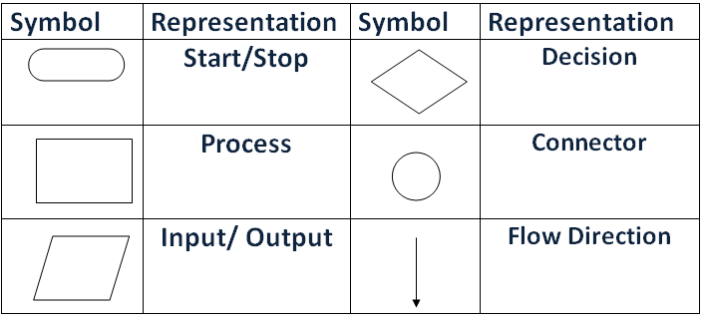
BLOCK SYMBOLS

Slide 18
PROBLEM EXAMPLE:
Find the average of a given set of numbers
SOLUTION:
In developing flow charts, consider the ff steps:
Try to understand the problem
i. Write down some numbers and find average manually (Noting each step carefully).
Count numbers
Add the numbers up
Divide result by numbers counted
Devise a plan
i. How do we count the numbers?
ii. How do we add the numbers?
iii. How do we compute the average?

Slide 19
Identify patterns, repetitions and familiar tasks
i. Familiarity: Unknown number of item? i.e. n item
ii. Patterns: Look at each number in the list
iii. Look at a number
Add number to sum
Add 1 to counter
Carry out the plan
Check each step
Consider special cases
Check result
Check boundary conditions:
i.e. what if the list is empty?
Division by 0?
Are all numbers within the specified range?

Slide 20
Start
Total = 0
Average = 0
Count = 0
Count =0?
More
numbers?
Read Number
Yes
No
Yes
No
Average = Total/Count
Total = Total + Number
Count = Count + 1
Print Average
Stop

Slide 21
How to write Pseudocode
An algorithm can be written in pseudo code using six basic computer operations:
A computer can receive information e.g. Get name, read name
A computer can output (print) information e.g. print name
A computer can perform arithmetic operation e.g. Add num1 to total.
A computer can assign a value to a piece of data
A computer can compare two pieces of information and select one of two alternatives. E. g. “If – else statements”
A computer can repeat a group of actions
e.g. repeat until total = 50

Slide 22
Characteristics of a good program
It solves the right problem.
The implementation is error-free.
The program is well documented.
The program is maintainable.
The program must be robust (survive unexpected events).
Elements of a programming style
Choice of identifiers (use meaningful identifiers)
Use nouns to name data objects such as variables and constants.
Use verbs to name procedures eg. Get_Next_Char

Slide 23
Program Presentation Issues
Comments
Constitute a major component of a program’s
internal documentation. Gives further understanding to the intent or purpose of portions of code.
Indentation
Indentation (or paragraphing) is another important programming technique that enhances the readability and reveal the logical structure of the program or algorithm.
Effective Use of White Spaces
Most programming languages allow the use of blank lines spaces embedded within the program code to improve its readability

Slide 24
The best way to learn a programming language is to
try writing programs and test them on a computer.
To write and test your program, you need:
An editor with which to write and modify the C++ program components and source code.
A compiler: This is a program that reads source code file and translates to an executable or binary file that is the format the computer will understand.
A linking program with which to link the compiled program components and existing libraries.
A debugger to help diagnose problems in the compiling programs.

Slide 25
A bug is a mistake in a program. It may be either a
syntax or logic errors.
Syntax errors are programming errors caused by
typographical errors and incorrect use of programming language.
Logic errors are caused by incorrect use of control structures.
There are several editors available, example Microsoft visual C++, an integrated development environment (IDE) that combines an editor, compiler, a linking program and a debugger in a single programming environment.

Slide 26
INTRODUCTION TO MATLAB

Slide 27
MATLAB is a powerful language for technical computing.
MATLAB stands for MATrix LABoratory because its basic data element is a matrix (array).
The standard MATLAB program has tools(functions) that can be used to solve common problems.
MATLAB also has optional toolboxes that are a collection of specialized programs designed to solve specific problems.

Slide 28
Window | Purpose
Command Window | Main window, enters variables, runs programs.
Figure Window | Contains output from graphic commands
Editor Window | Creates and debugs script and function files
Help Window | Provides help information
Launch Pad Window | Provides access to tools, demos and documentation
Command History Window | Logs commands entered in the Command Window
Workspace Window | Provides information about the variables that are used
Current Directory Window | Shows the files in the current directory
Table 1. MATLAB Windows

Slide 29
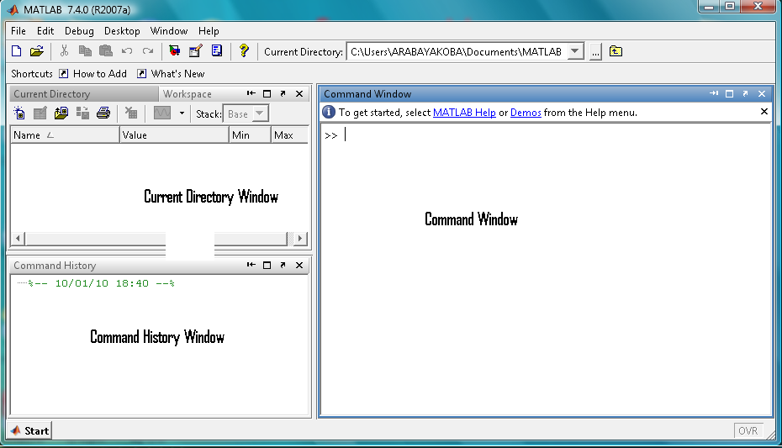
The default view of MATLAB desktop

Slide 30
Notes for working in the Command Window
To type a command the cursor must be placed next to the command prompt (>>).
Once a command is typed and the ENTER key is pressed, the command is executed. However only the last command is executed.
Several commands can be typed in the same line.
Comma (,) is used to separate various commands.

Slide 31
It is not possible to go back to a previous line in the Command Window, make a correction and the re-execute the command.
A previously typed command can be recalled to the command prompt with the up-arrow key ( ). When the command is displayed at the command prompt, it can be modified if needed and executed. The down-arrow key ( ) can be used to move down the previously typed commands.

Slide 32
If a command is too long to fit in one line, it can be continued on the next line by typing three periods ... (called an ellipsis) and pressing the Enter key.
The semicolon (;)
If a semicolon is typed at the end of a command the output is not displayed. Used when the result is obvious or when the output is very large.
Typing %:
This is used to show a comment. Comments are used in programs to add descriptions, or to explain the program.

Slide 33
The clc command
The clc command (type clc and press Enter) clears the Command Window.
All variables declared earlier on can still be used.
ARITHMETIC OPERATIONS WITH SCALARS
Operation Symbol Example
Addition + 5+3
Subtraction – 5–3
Multiplication * 5*3
Right Division / 5/3
Left Division \ 5\3 =3/5
Exponentiation ^ 5^3(means5³=125)

Slide 34
Order of precedence
MATLAB executes the calculations according to the order of precedence as shown below:
Precedence Mathematical Operation
First Parentheses ()
Second Exponentiation
Third Multiplication and division
Fourth Addition and subtraction

Slide 35
Display Formats
Command | Description | Example
format short | Fixed-point with 4 decimal digits for: 0.001≤number≤1000 | >>format short >>290/7 ans= 41.4286
format long | Fixed-point with 14 decimal digits for: 0.001≤number≤100 | >>format long >>290/7 ans= 41.42857142857143
format short e | Scientific notation with 4 dec digits | >>format short e >>290/7 4.1429e+001
format long e | Scientific notation with 15 dec digits | >>format long e >>290/7 ans= 4.142857142857143e+001

Slide 36
Command | Description | Example
Format short g | Best of 5-digit fixed or floating point | >>Format short g >>290/7 ans= 41.429
Format long g | Best of 15-digit fixed or floating point | >>Format long g >>290/7 ans= 41.4285714285714
Format bank | Two decimal digits | >>Format bank >>290/7 ans= 41.43
Format compact | Eliminates empty lines to allow more lines with information displayed on the screen.
Format loose | Adds empty lines (opposite of compact)

Slide 37
Elementary MATH Built-in Functions
MATLAB has a very large library of in-built functions.
A function has a name and an argument in parentheses.
For example, the function that calculates square root of a number is sqrt(x).
The name is sqrt and the argument is x.

Slide 38
Function | Description | Example
sqrt (x) | Square root | >>sqrt(81) ans= 9
exp(x) | Exponential e^{x} | >>exp(5) ans= 148.4132
abs(x) | Absolute value | >>abs(-24) ans= 24
log(x) | Natural logarithm Base e logarithm (ln) | >>log(1000) ans= 6.9078
log10(x) | Base 10 logarithm | >>log10(1000) ans= 3.0000
factorial (x) | The factorial function x! (x must be a positive number) | >>factorial(5) ans= 120

Slide 39
Command | Description | Example
sin(x) | Sine of angle x(x in radians) | >>sin(pi/6) ans= 0.5000
cos(x) | Cosine of angle x(x in radians) | >>cos(pi/6) ans= 0.8660
tan(x) | Tangent of angle x(x in radians) | >>tan(pi/6) ans= 0.5774
cot(x) | Cotangent of angle x (x in radians) | >>cot(pi/6) ans= 1.7321
The inverse trig functions are asin(x), acos(x), atan(x) and acot(x). The hyperbolic trigonometric functions are sinh(x), cosh(x), tanh(x) and coth(x)

Slide 40
Function | Description | Example
round(x) | Round to the nearest integer | >>round(17/5) ans= 3
fix(x) | Round towards zero | >>fix(13/5) ans= 2
ceil(x) | Rounds towards infinity | >>ceil(11/5) ans= 3
floor(x) | Rounds towards minus infinity | >>floor(-9/4) ans= -3
rem(x, y) | Returns the remainder after x is divided by y. | >>rem(13,5) ans= 3
sign(x) | Signum function. Returns 1 if x>0, -1 if x<0 and 0 if x=0 | >>sign(5) ans= 1

Slide 41
Defining Scalar Variables
A variable is a name made of a letter or a combination of several letters (and digits) that is assigned a numerical value. A variable is a name of a memory location.
Once a variable has been assigned a numerical value, it can be used in mathematical expressions, functions and any MATLAB statements and commands.
In MATLAB the = sign is called the assignment operator.
Variable_Name = A numerical value, or a computable expression

Slide 42
The left-hand side of the assignment operator can include only one variable name.
The right-hand side can be a number, or a computable expression that can include numbers and/or variables that were previously assigned values.
If a variable already exists, typing the variable’s name and pressing ENTER will display the variable and its value.
Several assignments can be typed on the same line with a comma (,) separating them.

Slide 43
Rules about variable names
Variable names:
Can be up to 63 characters long(in MATLAB 7) and 31 characters long in MATLAB 6.0.
Can contain letters, digits and the underscore (_)character .
Must begin with a letter
MATLAB is case sensitive; for example AA, Aa, aA and aa are names of 4 different variables
Avoid using the names of a built-in function for a variable.
Predefined Variables
Examples include:
ans
pi The number π
eps The smallest difference between two numbers
inf Used for infinity
i or j Defined as , which is 0+1.0000i (or j)
NaN Not-a-Number. E.g. 0/0

Slide 44
Useful Commands for Managing Variables
Command | Outcome
clear | Removes all variables from the memory
clear x y z | Removes only variables x, y and z from the memory
who | Displays a list of the variables currently in memory
whos | Displays a list of the variables currently in the memory and their size together with information about their bytes and class

Slide 45
INTRODUCTION TO C++
C++ extends the C programming language
C++ is an object-oriented, high level language used to write programs.
High-level programming languages are those whose syntax is relatively close to the natural language.
Syntax is the rules of a programming language that specify how words and symbols are put together.
Object-oriented languages reflect a particular way of thinking about tasks in terms of identifying and describing the behaviour and state of the relevant objects.

Slide 46
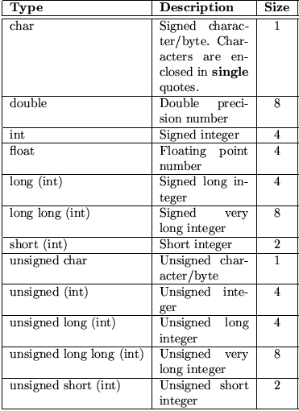

Slide 47
An example C++ Program
#include<iostream>
using namespace std;
int main()
{
cout<<“Hello World!\n”;
system(“pause”);
return 0; //0 is returned to the computer’s operating system to signal that the program has completed successfully.
}

Slide 48
#include <iostream> - this tells the preprocessor to include code from the file “iostream”.
iostream contains definitions of the routines that handle input from the keyboard and output to the screen.
using namespace std (called the using directive). This tells the compiler that the program will be using names that have a meaning defined in the std namespace.
int main() : This statement declares the main function. C++ program must always have one main function.

Slide 49
A function is a self-contained module of code that can accomplish some task.
The int specifies the return type of main to be an integer.
“{ }” The opening and close brackets denotes the start and end of the program respectively.
“cout<<“ and “cin>>” are objects from a standard C++ library that has a method used to print strings to screen and accepts inputs from the keyboard respectively.
“\n” (new-line character) – tells the computer to start a new line of output.
; every line of code must end with a semicolon.
return 0 : 0 is returned to the OS to signal that the program has completed successfully.

Slide 50
VARIABLES
A variable represents a location in the computer’s memory.
A variable in C++ is used to hold data within programs.
Every variable has 2 parts; a name and a data type.
The name identifies the variable and data type describes the type of data stored or returned by the variable.

Slide 51
VARIABLE NAMES
Valid names can consist of letters, numbers and the underscore (_).
It must not start with a number.
A variable name may not be a C++ keyword such as if, for, else or while.
Variable names are case sensitive .
Keywords in C++ have predefined meaning that cannot be changed.

Slide 52
DATA TYPES
C++ requires that all variables used in a program be given a data type.
Data type is the type of data a variable returns.
C++ allows user-defined data types.
It also provides built-in data types such as boolean, character, float and integer.
Boolean variables are declared with the keyword bool and contain one of two values; true or false.
Variables of these types are defined simply by preceding the name with the type:
int an_int;
float a_float;
long long a_very_long_integer;

